Slide 1

AUC and ROC Curve
Eunice Oyeniyi

Slide 2
What AUC and ROC are all about
ROC (Receiver Operating Characteristic Curves)
Its one of the most common evaluation metrics for checking a classification model’s performance.
ROC measures the performance of a classification model by plotting the rate of true positives against false positives.
ROC shows the performance of a classification model at all possible threshold and hence helps determine the right threshold value for the problem

Slide 3
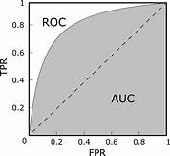

Slide 4
AUC is the entire area beneath the ROC curve
It measures how well a model is able to distinguish between classes. More like a summary of ROC curve.
AUC provides summary of how good is your model performance as a whole and it provides the quality score describing its overall performance.
It is the probability that a classifier will rank a randomly chosen positive instance higher than a randomly chosen negative one.
The higher the AUC the better i.e the close it is to 1 the better

Slide 5
Thank You For Listening

